Slide 1
DB
Creating and managing tables in MySQL

Slide 2

OBJECTIVES FOR TODAY
Manage MySQL database
create database
delete database
Manage MySQL table
create table
delete table
set columns types

Slide 3



SOME KEY WORDS !!!!
CREATE
MODIFY
DROP
CREATE A A TABLE, A DATABASE
CHANGE A COLUMN
DELETE A DATABASE, A TABLE

Slide 4






How to connect to a database system ?
SERVER
CLIENT
IN 3 WEEKS !
USING NODE JS
PROJECT
WEP SERVER
NOW
USING SQL SCRIPT
DATABASE
SYSTEM

Slide 5

What is MySQL ?
A relational database management system (RDMS)
CREATE
MODIFY
data from a relational database
A language to
EXTRACT

Slide 6


What is XAMPP ?
XAMPP is a CROSS PLATFORM application providing many services:
A HTTP web server
=
A MySQL server
A PHP interpreter

Slide 7
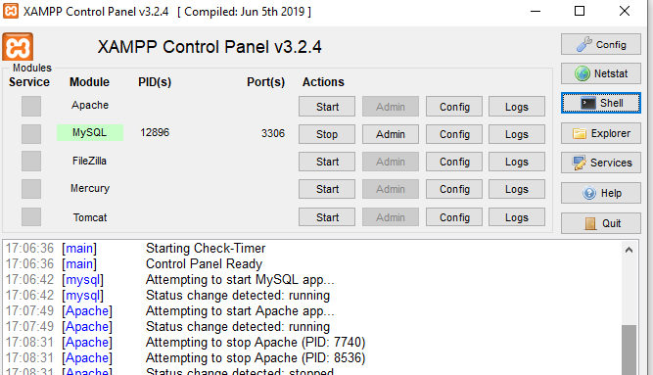
Let’s connect to the RDMS
1 – RUN XAMPP
2 – ACTIVATE MYSQL

Slide 8
Launch a terminal and run mysql programm
C:\xampp\mysql\bin> .\mysql.exe -uroot
USER = root
By default
PASSWORD = no password

Slide 9
CREATE DATABASE
DELETE DATABASE

Slide 10

Create a database
CREATE DATABASE your database ;
Want to create database only if NOT existing?
CREATE DATABASE IF NOT EXISTS <db>

Slide 11
Select database to work with
USE <your database>;

Slide 12
Remove a database
DROP DATABASE <your database>;

Slide 13
CREATE TABLE
SET COLUMN PROPERTIES
DELETE TABLE

Slide 14
Create a table
CREATE TABLE <your table>
( column1 datatype, column2 datatype, … );

Slide 15
Remove a table
DROP TABLE <table name>;

Slide 16
Most common My SQL types
TYPE | Description | Example
CHAR( fixeSize) | A FIXED length string | toto
VARCHAR(maximumSize) | A VARIABLE length string - From 0 to maximumSize characters | toto
BINARY | A binary value
BOOLEAN | Zero is considered as false, other than is considered as true. | 1 (True), yes 0 (False), no
INTEGER |  | 45
FLOAT |  | 42.5
DATE | A date - Format: YYYY-MM-DD | 2021-06-05
TIME | A time Format: hh:mm:ss | 11:45:00
DATETIME | A date and time Format: YYYY-MM-DD hh:mm:ss | 2021-06-05 11:45:00
See more type :
https://www.w3schools.com/mysql/mysql_datatypes.asp

Slide 17
Create your first SQL table
PET | STUDENT
 | name owner sex birth death | VARCHAR(20) VARCHAR(20) CHAR(1) DATE DATE
CREATE TABLE pet (
name VARCHAR(20), owner VARCHAR(20), sex CHAR(1),
birth DATE, death DATE
);

Slide 18
3 nice columns properties
NOT NULL = value cannot be null
NULL = value can be null
CREATE TABLE Persons ( personId int , lastName varchar(255) NOT NULL, firstName varchar(255), age int DEFAULT (20), PRIMARY KEY (personnId) );
By default age value is 20
Define the PRIMARY KEY

Slide 19
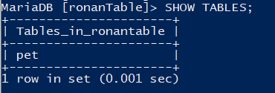
Show all tables
SHOW TABLES;

Slide 20
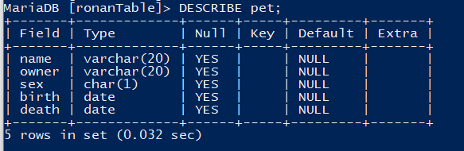
Display the structure of a table
DESCRIBE tablename;
Is it a KEY column or not
The default value
The data type of your column
If it can take NULL values or not
The columns of your table

Slide 21
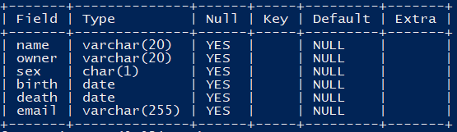
Add a table column
ALTER TABLE pet
ADD email varchar(255);
Column
name
Column
type
New column added

Slide 22
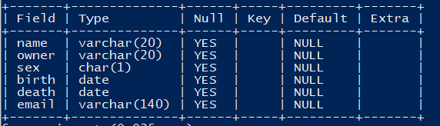
Change a table column
ALTER TABLE pet
MODIFY email varchar(140);
Column
name
Column
type
Column modified

Slide 23
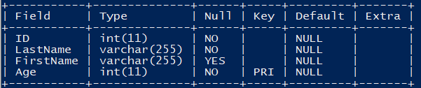
Remove a table column
ALTER TABLE pet
DROP email;
Column
name
column email removed

Slide 24
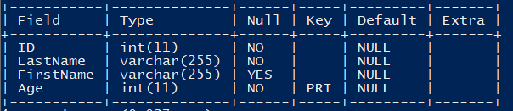
Change a primary key
ALTER TABLE Persons
DROP PRIMARY KEY,
ADD PRIMARY KEY (Age);
Remove previous PK
Set the new PK

Slide 25

MANIPULATE
ACTIVITY 1
10 MIN
1. Create the following table
Employee
PK | employeeID firstName sex birth | VARCHAR(200) VARCHAR(100) CHAR(1) DATE | NOT NULL NOT NULL
2. show the result of your table creation
Notes:
They open the activity 2 and complete the word
ANSWERS
Q1 : elements are organized as containers (div contain p and buttons…)
Q2 : the identifiers can be the class (some items have the same class example : title) or the id (an id is unique)
They are used in CSS for the style, but they can also be used by javascript
Q3 : if you delete a container, everything that is contained by it is deleted too.
------------------------------------------
Show the html code in the dev tools, and ask what are all the class for.
-> they are used as reference so that css may use it, but also js !
-> build a parallel between css and js : placement in the Document, but also reference to objects.
-> end by describing the content of the page in order of DOM hierarchy
•Document
•header/body
• each header/body have their div, paragraphs
• each div contains paragraph or Images…

Slide 26
ACTIVITY 2
10 MIN
CREATE TABLE tasks (
taskId INT(11) NOT NULL,
subject VARCHAR(45),
startDate DATE DEFAULT "2021-06-11",
endDate DATE,
description VARCHAR(200) NOT NULL,
PRIMARY KEY (taskId )
);
QUESTIONS:
What are the columns of the table tasks?
Which column is the primary key?
What is the type of subject?
Can end_date be NULL or not?
Can description be NULL or not?
What is the default value of start_date?
Notes:
They open the activity 2 and complete the word
ANSWERS
Q1 : elements are organized as containers (div contain p and buttons…)
Q2 : the identifiers can be the class (some items have the same class example : title) or the id (an id is unique)
They are used in CSS for the style, but they can also be used by javascript
Q3 : if you delete a container, everything that is contained by it is deleted too.
------------------------------------------
Show the html code in the dev tools, and ask what are all the class for.
-> they are used as reference so that css may use it, but also js !
-> build a parallel between css and js : placement in the Document, but also reference to objects.
-> end by describing the content of the page in order of DOM hierarchy
•Document
•header/body
• each header/body have their div, paragraphs
• each div contains paragraph or Images…

Slide 27
Activity (correction)
Q1) The columns are task_id, varchar, start_date, end_date, dexcription
Q2) We have the statement “PRIMAY KEY(task_id)”, so task_id is the primary key
Q3) subject data type is a string which maximum length is 45 characters because we have ”subject varchar(45)
Q4) end_date can be NULL because we indicate NULL next to the data type
Q5) description NOT NULL
Q6) The default value of start_date is 2021-06-11

Slide 28
GOOD LINKS
https://www.w3schools.com/sql/sql_syntax.asp
https://dev.mysql.com/doc/mysql-tutorial-excerpt/8.0/en/database-use.html
https://www.techonthenet.com/mysql/index.php

Slide 29
OBJECTIVES FOR TODAY
Manage MySQL database
create database
delete database
Manage MySQL table
create table
delete table
set columns types

